Slide 1
From ~10
To ~10M
In ~10
Adam Lev // Tamar Labs // 2016

Slide 2
that 3 trope guy again?
Adam Lev // Tamar Labs // 2016

Slide 3
Big
Data
Adam Lev // Tamar Labs // 2016

Slide 4
Big Fast
Data
Adam Lev // Tamar Labs // 2016

Slide 5
A Trope
Google: a significant or recurrent theme; a motif.
Myself: something useful you’ve kind of seen before.

Slide 6
A Trope
Google: a significant or recurrent theme; a motif.
Myself: something useful you’ve kind of seen before.
=

Slide 7
Hello!
I’m not* a python programmer
I know nothing* about GIS
I don’t believe in Big Data*

Slide 8
I Love hating Big Data
Is often used as a big stick to deter the competition
Or even worse - to impress clients that you are smarter than you truly are
Storing time series data in a table makes no sense
Wrong assumptions about your data and what you can say by looking at it
Maximizing state and minimising scalability
When we actually want to...

Slide 9
minimizing state dependency

Slide 10
thinking
in
critical sections

Slide 11
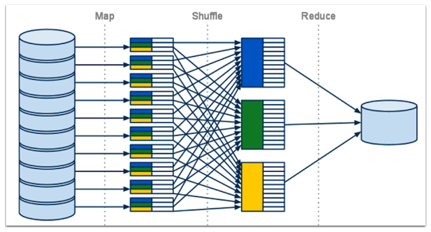
Know This? This is Big Data

Slide 12
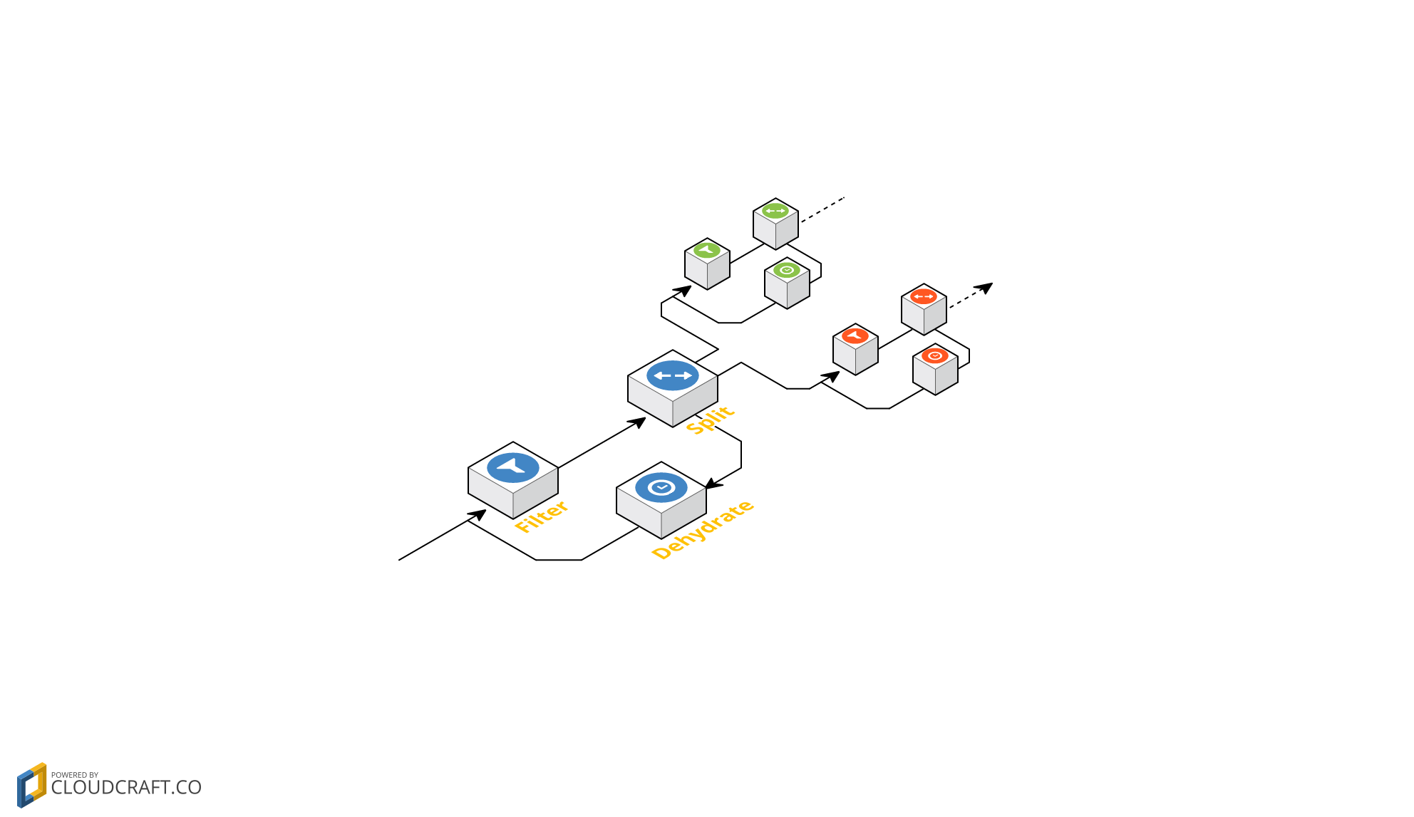
This is streaming data

Slide 13
Handling Uncertainty

Slide 14
The Tijuana Problem - a case study
Real time and retro matching of questions and users based on geolocation (as polygon)

Slide 15
active
users
live
questions

Slide 16
The Real Problem
< 1000 users

Slide 17
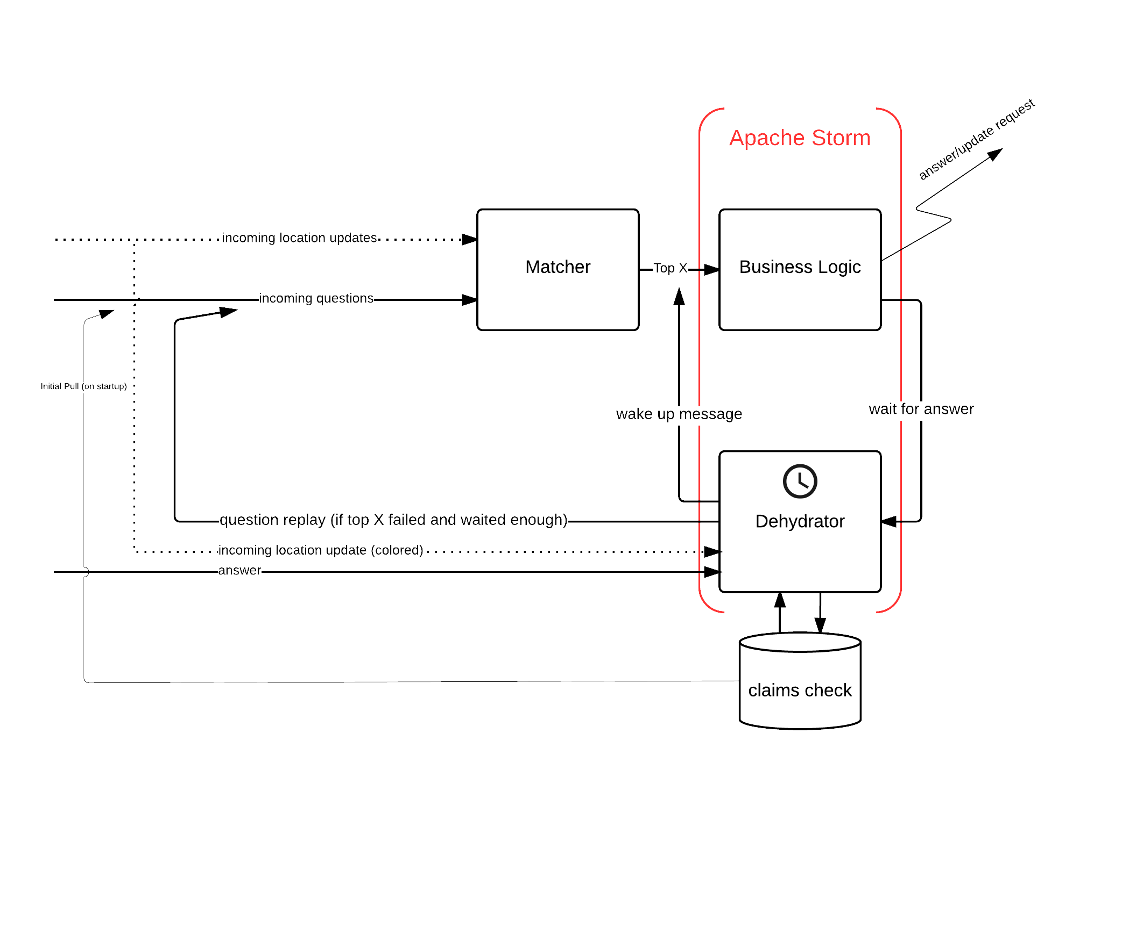

Slide 18
This is streaming data

Slide 19
The meat on the bone
>20,000,000 concurrent active user events

Slide 20
R-Tree

Slide 21
R-Tree
Storm
Storm

Slide 22
Redis
R-Tree
redis
Storm
redis
Storm
Redis

Slide 23
I Love streaming data
It handles with uncertainty pretty well
The code is built from small, maintainable chunks
You can use whatever tools works for you

Slide 24
Still want your Big Data
You can have it

Slide 25
use whatever works for YOU

Slide 26

thank you
Github: geopython-storm-workshop
GeoScaleCourse.com
NullTerminatorBlog.com
adam@tamarlabs.com
null
terminator
blog

Slide 27
thank you
Github: geopython-storm-workshop
GeoScaleCourse.com
NullTerminatorBlog.com
adam@tamarlabs.com
null
terminator
blog

